Slide 1


Leveraging Machine Learning for Depression Screening A Step Towards Proactive Intervention
PGPDSE – Hyd, Mar’24
TeamONE
Dileep, Praneeth, Sreekar, Ghouse, Sreehitha, Kalyani
Mentored by - Ankush Bansal

Slide 2
Leveraging Machine Learning for Depression Screening A Step Towards Proactive Intervention
PGPDSE – Hyd, Mar’24
TeamONE
Dileep, Praneeth, Sreekar, Ghouse, Sreehitha, Kalyani
Mentored by - Ankush Bansal

Slide 3
INDEX
Problem Statement
Background research
Dataset
Getting to know about data
All charts
EDA
Nulls
Encoding
Scaling
Model build
Metrics display Function
All Models
Hyperparameter Tunning
Optuna
Deployment
Pipeline
HTML & CSS
Flask
Render

Slide 4

ABOUT PROBLEM

Slide 5

PROBLEM
Team
One
“
The objective of this project is to develop and deploy a predictive classification model to identify individuals at risk of depression based on a variety of demographic, lifestyle, and medical factors.

Slide 6
BACKGROUND
Team
One
The Silent Epidemic:
Depression affects millions globally, impacting all aspects of life. While 3.8% of the population experience it, the true number is likely higher due to stigma and lack of access to care.
More Than Just Sadness
Depression isn't simply feeling down. it's a complex mental health disorder with debilitating symptoms like loss of interest, hopelessness, and suicidal thoughts. These can disrupt work, relationships, and overall well-being.
A Multifaceted Challenge
Depression arises from a combination of social, psychological, and biological factors. Stressful life events, physical health issues, and even genetics can play a role.

Slide 8
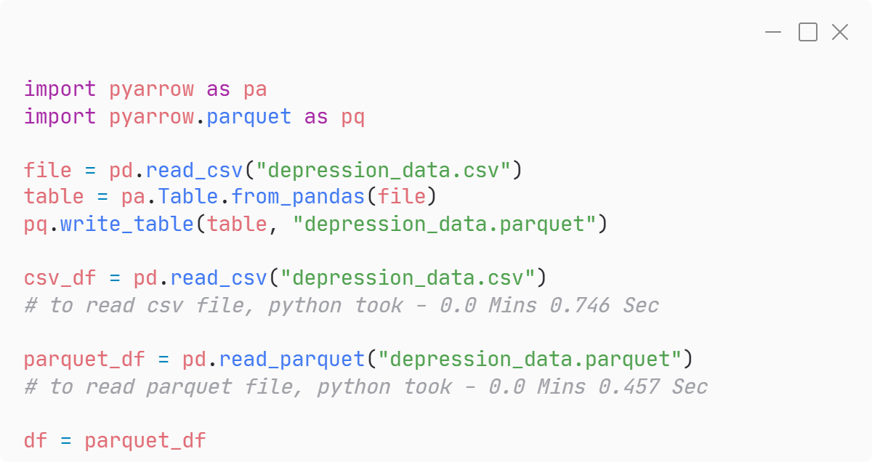
Dataset
Team
One
Converting from *.csv to *.parquet
Parquet is an open-source columnar storage file format designed for efficient data processing. Unlike CSV, which stores data row-by-row, Parquet stores data column-by-column. This columnar organization offers several key advantages
Faster data loading
Reduced storage space
Improved data integrity
Enhanced performance for machine learning tasks
40%
*.parquet
file took
less time to load
that *.csv file

Slide 9
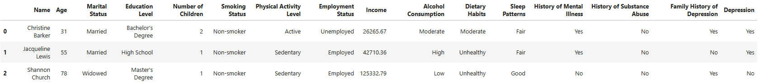
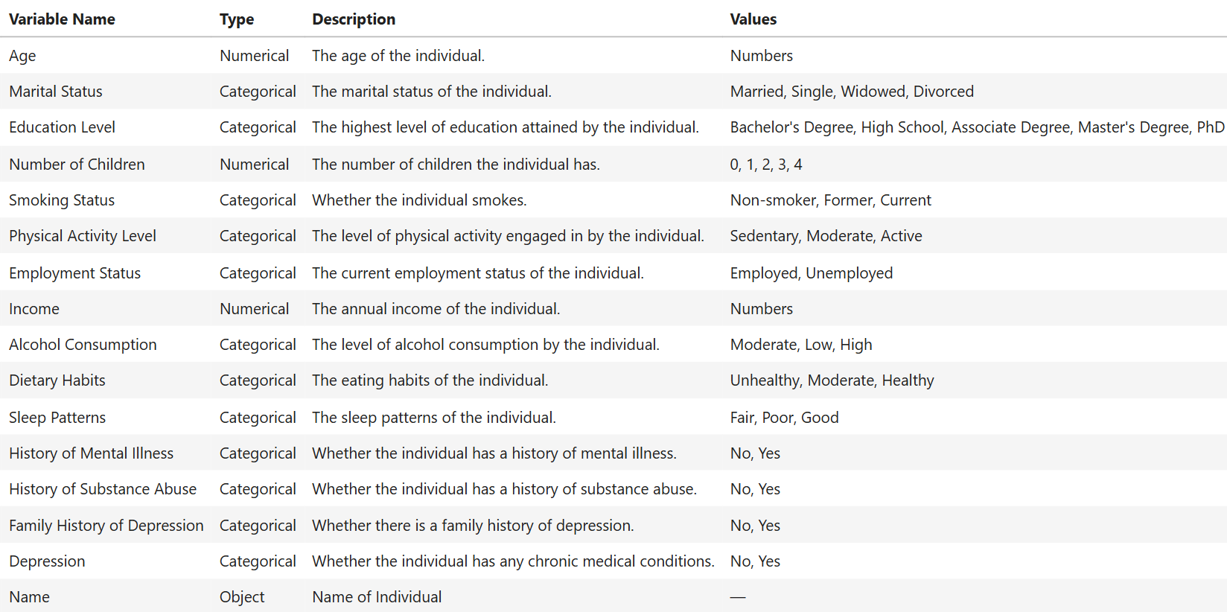
Dataset
Team
One
Shape
Rows : 4,13,768
Columns : 16
Dtypes Columns
Categorical : 13
Numerical : 2
Object : 1

Slide 10
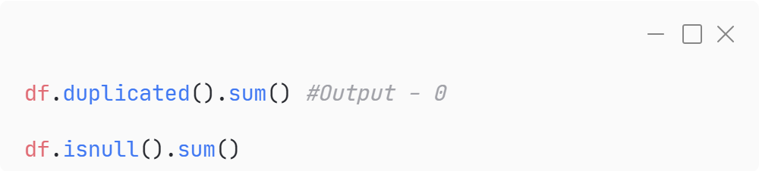
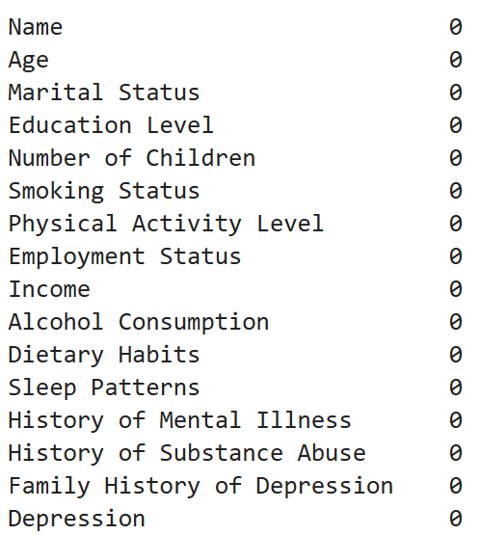
Nulls & Duplicates
Team
One
<.py code>
Why..?
Algorithm Compatibility
Biased Analysis
Reduced Statistical Power
There are no Null Values in this Dataset
There are no Duplicate Values in this Dataset

Slide 11
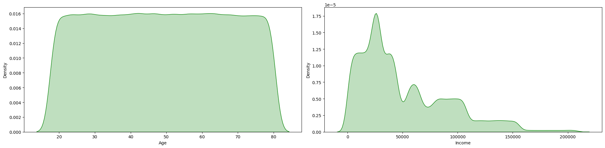
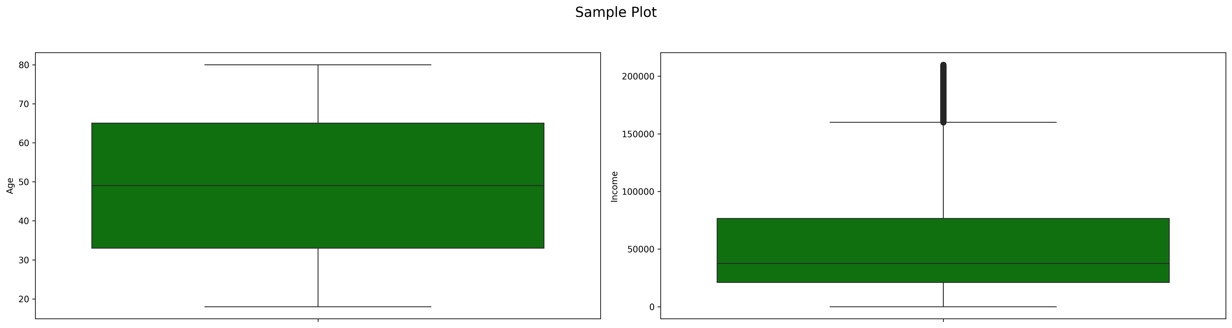
Univariant Analysis
Team
One
AGE INCOME

Slide 12
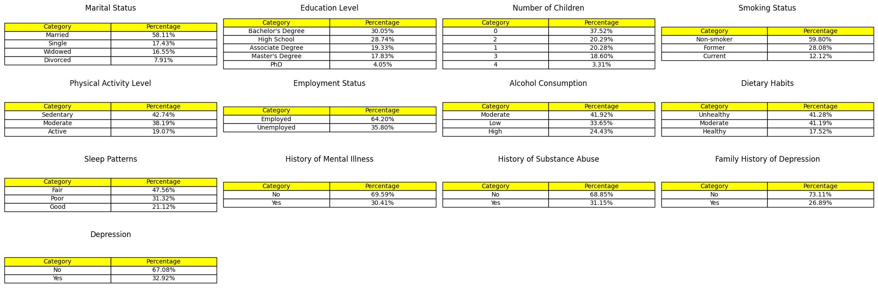
Univariant Analysis
Team
One

Slide 13
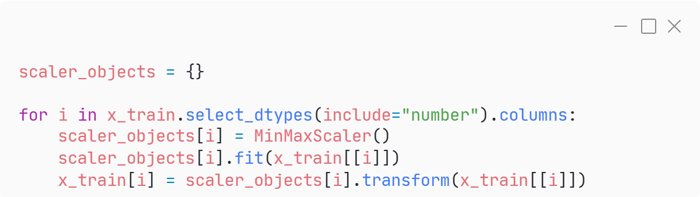
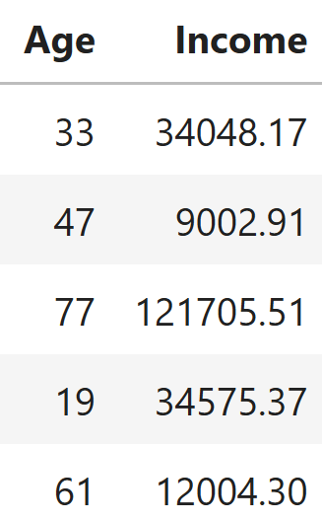
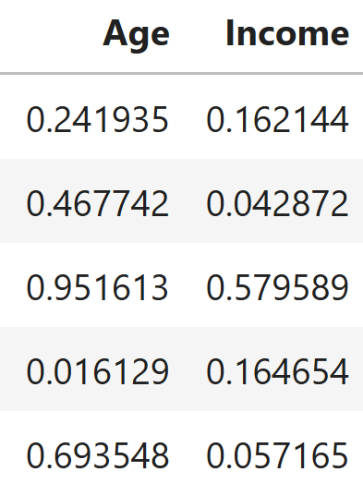
Scaling
Team
One
Why..?
Equalizing Feature Influence
Improving Algorithm Performance
Preventing Domination by Large Values
We used “MinMax Scaler”, because of the outliers in “income” variable.
We have done “fit_transform” on training data, and just “transform” on testing data to prevent data leakage. Because the test data should be hidden from the model so that overfitting will not happen.
<.py code>
Before Scaling
After Scaling

Slide 14
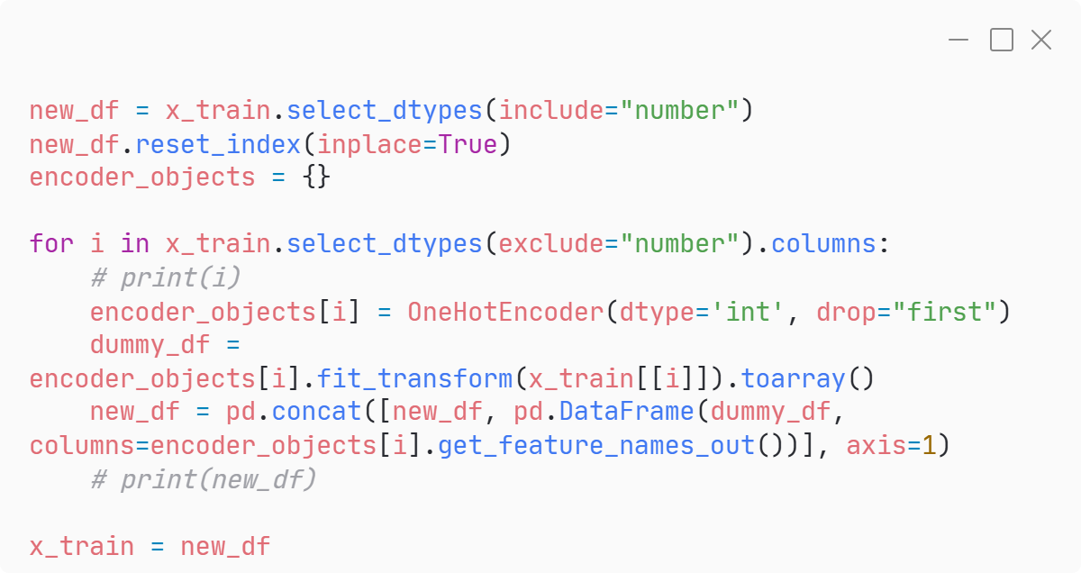
Encoding
Team
One
Why..?
Algorithm Compatibility
We used “One Hot Encoding” to make 14 categorical variables as numerical.
We have done “fit_transform” on training data, and just “transform” on testing data to prevent data leakage. Because the test data should be hidden from the model so that overfitting will not happen.
<.py code>

Slide 15
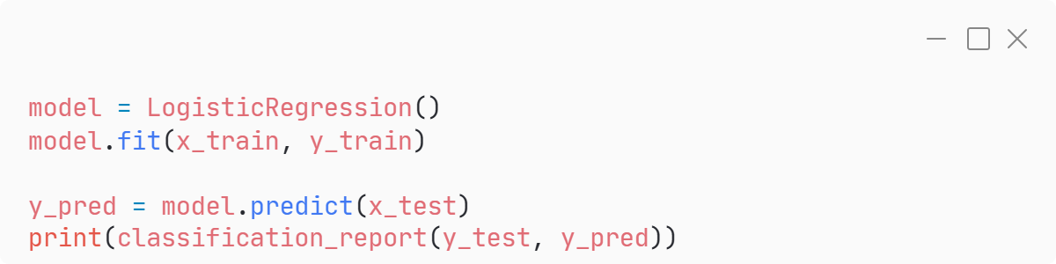
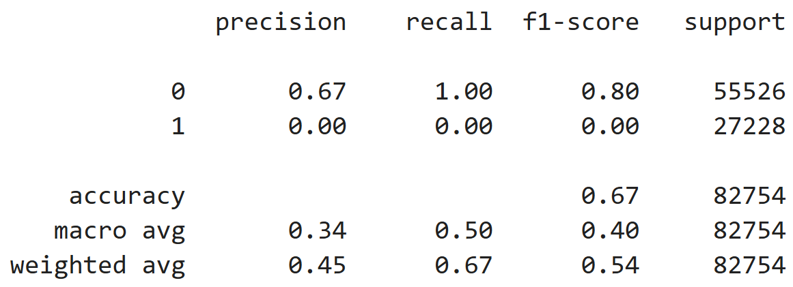
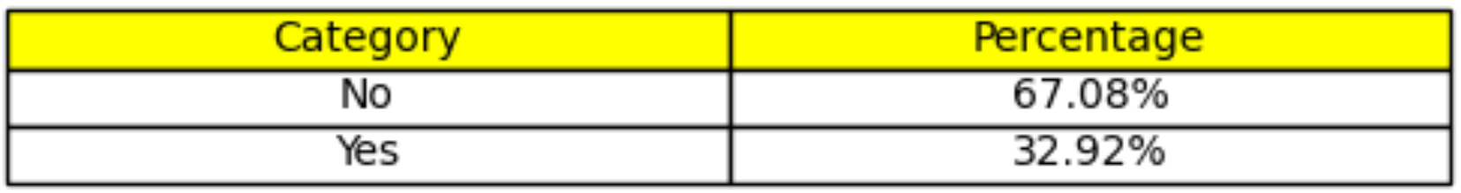
Base Model
Team
One
<.py code>
We have use “Logistic Regression” is a base model. It gave 67% accuracy, but the model failed to detect class 1 datapoints in test data.
Possible Reasons for failing of algorithm:
Class Imbalance
Insufficient Features
Model Limitations
Classification Report

Slide 16
Works to be done:
Team
One
Will check if this data is satisfying the assumption of Linear Regression?
Linearity
Independence of Residuals
Homoscedasticity
Normality of Residuals
No Multicollinearity
Will do statistical tests to know which feature is important to predict target
Will do PCA to make sure there is no Multicollinearity.
Will do transformation on Numerical features
Will do hyperparameter tunning
Will check is this data performs better in clustering rather that classification
Will try various other classification algorithms
Will to feature engineering
Will make this whole algorithm dynamic using OOPs – (Pipeline)

Slide 17
THANK YOU
Please ask your question
PGPDSE – Hyd, Mar’24
TeamONE
Dileep, Praneeth, Sreekar, Ghouse, Sreehitha, Kalyani
Mentored by - Ankush Bansal

